Slide 1
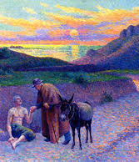
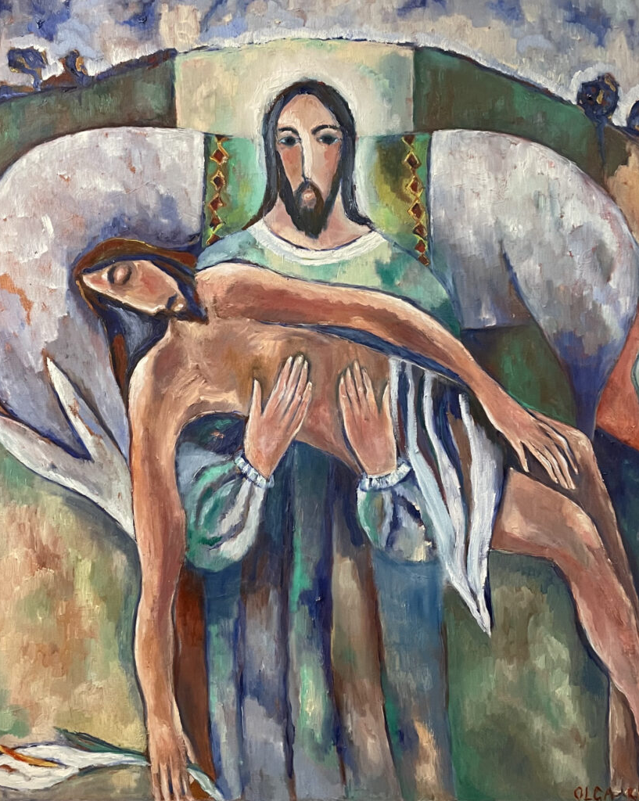
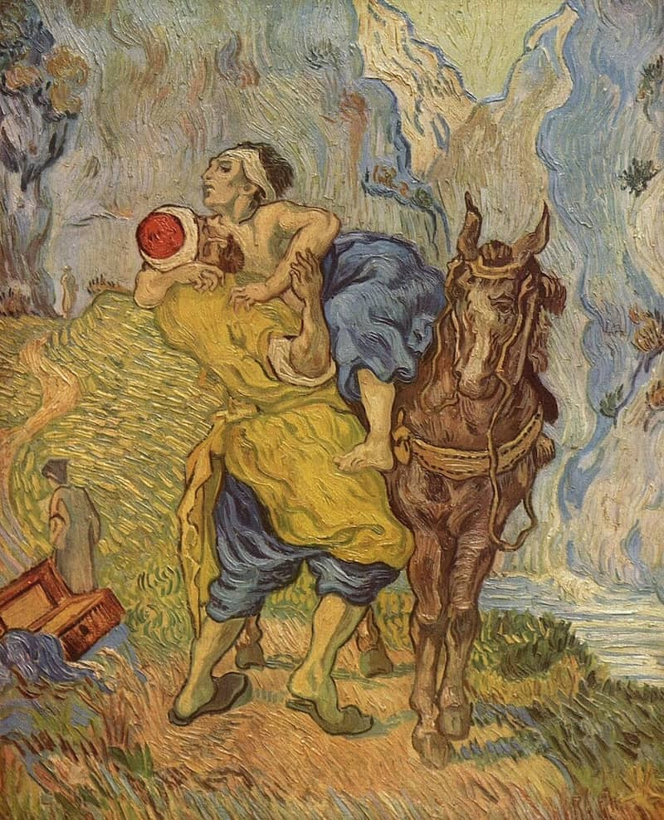
Parables: Class 1
FamilyID=Office_ArchiveTorn

Slide 2
What is a “parable”?
The word “parable” comes from combining two Greek words: Para – meaning “alongside” and Bole – meaning “throwing”
Short story using that uses a concrete narratives to unpack an abstract idea – often, though not exclusively, around moral concerns
Akin to a fable – an allegorical story that is not real/true, but that contains truth. “An earthly story with a heavenly meaning”, in the words of William Barclay

Slide 3
What is a “parable”?
Occasional examples from the Old Testament:
2 Samuel 12:1-4
There were two men in a certain city, one rich and the other poor. The rich man had very many flocks and herds; but the poor man had nothing but one little ewe lamb, which he had bought. He brought it up, and it grew up with him and with his children; it used to eat of his meagre fare, and drink from his cup, and lie in his bosom, and it was like a daughter to him. Now there came a traveler to the rich man, and he was loath to take one of his own flock or herd to prepare for the wayfarer who had come to him, but he took the poor man’s lamb, and prepared that for the guest who had come to him.’

Slide 4
Jesus and Parables
Nearly one-third of Jesus’ teaching was done in parables
Debate exists around what qualifies as a parable, but there are likely around 30-40 unique parables within the Gospels, some of which are attested in multiple Gospels
Jesus used these parables to invite followers and hearers to wrestle and reshape their understanding

Slide 5
Jesus and Parables
Meanings are not always readily apparent – or satisfying:
Luke 8:9-10 -- Then his disciples asked him what this parable meant. Jesus said, “To you it has been given to know the secrets of the kingdom of God, but to others I speak in parables, so that ‘looking they may not perceive and hearing they may not understand.’
Our minds are meant to sit with them – and we reshape them into our present context

Slide 6
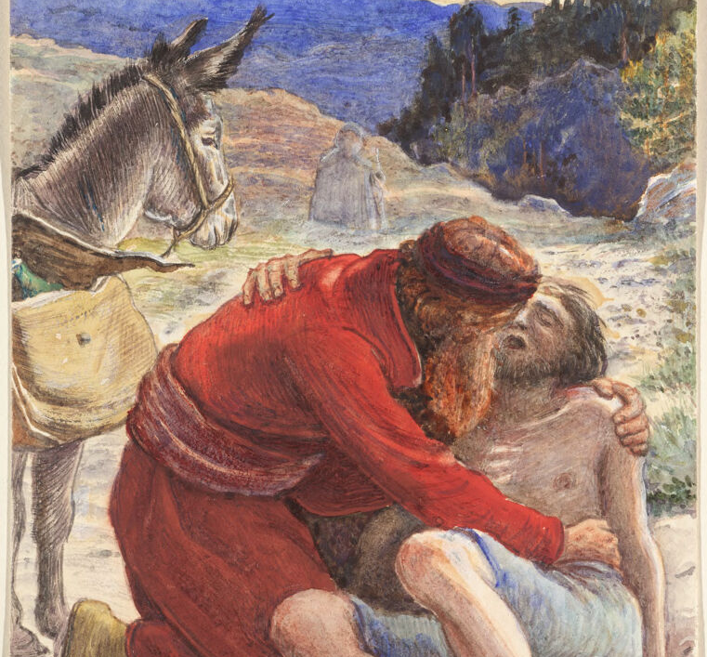
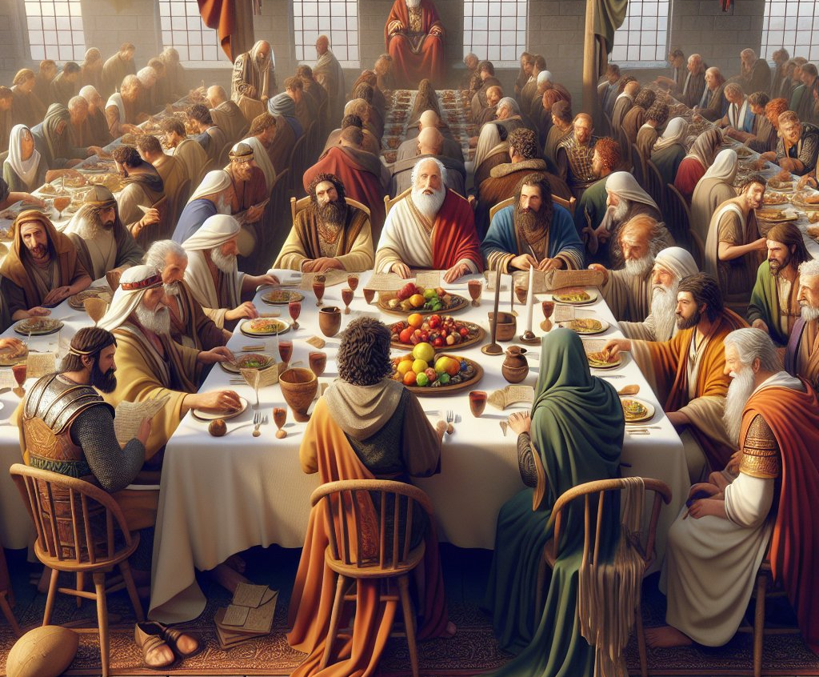
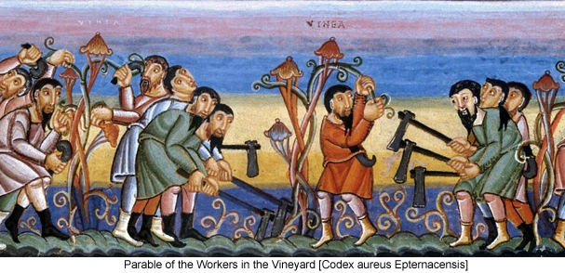
Who belongs in God’s Kingdom? Parable of the Good Samaritan Parable of the Wedding Feast Parable of the Laborers in the Vineyard

Slide 7
The Good Samaritan
Luke 10

Slide 8
Parable of the Good Samaritan
Only appears in Luke’s Gospel (Luke 10:25-37), despite being perhaps the best-known parable Jesus ever told
Framed by a conversation with a lawyer about “What must I do to inherit eternal life?”
Expansion of the “Greatest Commandment” passage found in Matthew 22:34-40 and Mark 12:28-34

Slide 9
Parable of the Good Samaritan
Understanding the various people/places in the parable
Jerusalem to Jericho
18-mile journey east; known as the “Way of Blood”
Priest
Likely a temple priest similar to Zechariah in Luke 1
Levite
Descendant from the Tribe of Levi; often viewed as equivalent to priests but they played other roles at the Temple beyond priesthood
Innkeeper
Little to speculate, but two denarii was around $100-150

Slide 10
Parable of the Good Samaritan
Complicating the “villains” of the story: the priest and the Levite who pass by the injured man
Often depicted as passing by without compassion, in total indifference, or hurrying by in fear
Numbers 5:2 – “Put out of the camp… everyone who is unclean through contact with a corpse”

Slide 11
Parable of the Good Samaritan
A Brief History of the Samaritans
Ancient Roots
Samaritan tradition states that they are the remnants of the Northern Kingdom of Israel in the wake of the Assyrian captivity
Adhere to the “Samaritan Pentateuch”, or first 5 books of the OT
Close relationship with those in the Southern Kingdom
Historic Antagonism
In 2nd century BCE, Samaritans backed the occupying Greek rulers under Antiochus IV, even when the Jewish people rebelled
In response, Israel would later destroy the Samaritan Temple around 110 BCE – leading to a sharp break between the two

Slide 12
Parable of the Good Samaritan
A Brief History of the Samaritans
In Jesus’ time
Israel (Judea) would become a client state of Rome around 37 BCE under Herod the Great, along with the surrounding areas of Samaria and Idumea – Herod the Great was actually Idumean
After Herod the Great’s death, Rome divided rule first between his sons, before finally making the entire area a Roman province known as Judaea in 6 CE under Quirinius
This province of Judaea now held Judea, Idumea, Galilee, and Samaria under common Roman rule… while historical resentments simmered under the surface

Slide 13
Parable of the Good Samaritan
“Who is my neighbor?” is a question that likely holds much of this historic uncertainty behind it
Jesus – and Luke as a Gospel writer – is using this parable to challenge strict adherence to the Law and instead extend our view of the Greatest Commandment
Many other interpretations throughout history…

Slide 14
Parable of the Good Samaritan
Origen, Augustine and “Allegorical” Interpretations
Man who was beaten = Adam / humanity
Priest = the Law
Levites = the Prophets
Samaritan = Christ
Inn / Innkeeper = the Church
Added layer of the Samaritan’s return equating to Christ’s second coming

Slide 15
Parable of the Good Samaritan
Calvin, Martin Luther King Jr. and “Ethical” Interpretations
Calvin – “Mankind is knit together with a holy knot; we must not live for ourselves, but for our neighbors.”
MLK – “True compassion is more than flinging a coin to a beggar; it is not haphazard and superficial. It comes to see that an edifice which produces beggars needs restructuring.”

Slide 16
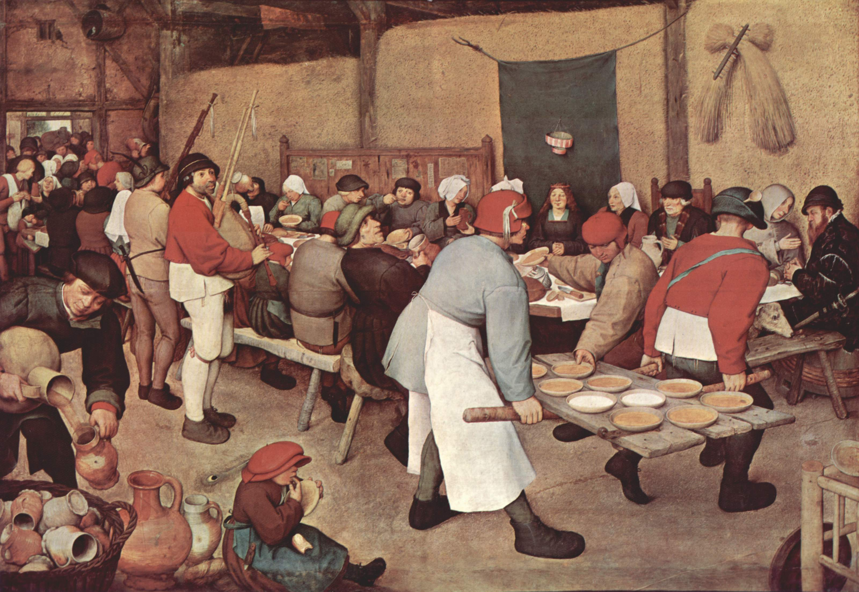

Slide 17
Parable of the Wedding Feast
Only in Luke’s Gospel (Luke 14:7-14), immediately preceding the better-known Parable of the Great Banquet
Setting would have been a 7-day wedding feast known as a seudat nissuin – same as the Wedding at Cana in John 2
Wider setting of a series of meals Jesus eats with the Pharisees in Luke (Luke 7, 11, and 14)

Slide 18
Parable of the Wedding Feast
First portion: Personal Humility
Proverbs 25:6-7: “Do not put yourself forward in the king’s presence or stand in the place of the great, for it is better to be told, “Come up here,” than to be put lower in the presence of a noble”
Humility as a running virtue in Luke’s Gospel – verse 11 is the quintessential “Great Reversal” that Luke loves to highlight: “For all who exalt themselves will be humbled, and those who humble themselves will be exalted”

Slide 19
Parable of the Wedding Feast
Second portion: Responsibility to the Humble
Isaiah 61:1 + Luke 4:18
“The Spirit of the Lord is upon me; he has anointed me to bring good news to the poor. He has sent me to proclaim release to the captives and recovery of sight to the blind and to let the oppressed go free”
Luke 7:22
“Go and tell John what you have seen and heard: the blind receive their sight, the lame walk, the lepers are cleansed, the deaf hear, the dead are raised, the poor have good news brought to them”

Slide 20
Parable of the Wedding Feast
Second portion: Responsibility to the Humble
Luke 14:12-14
“When you give a luncheon or a dinner, do not invite your friends or your brothers and sisters or your relatives or rich neighbors, in case they may invite you in return, and you would be repaid. But when you give a banquet, invite the poor, the crippled, the lame, and the blind. And you will be blessed because they cannot repay you, for you will be repaid at the resurrection of the righteous.”
Matthew 5:47 – 6:4, “truly I tell you, you have received your reward”

Slide 21
Parable of the Wedding Feast
Historic Interpretations
Practical wisdom – both parables are around social favor
Concern with Social Standing – particularly poignant for those within the early church, but a great challenge as Christianity became enmeshed in wider culture
Concern with Social Favors – When we give to others in our daily life, is it altruistic, or is it reciprocal?
Parable about God’s grace – who shall inherit the Kingdom of God?
Pushing back against earning our seat at a table – we should not assume or claim favor with God, nor give expecting reward
God’s consistent concern in the biblical text for those on the margins of society

Slide 23
Parable of the Laborers in the Vineyard
Only in Matthew’s Gospel (Matthew 20:1-16), immediately preceding the Rich Young Ruler (“camel through the eye of a needle”) and Peter’s concern over entering the Kingdom
Parable deals with agricultural day laborers, which would have been one of (if not the most) common jobs in the ancient world – and questions around payment

Slide 24
Parable of the Laborers in the Vineyard
Fundamental issues of fairness
Matthew 20:12-13 - ‘These last worked only one hour, and you have made them equal to us who have borne the burden of the day and the scorching heat.’ But he replied to one of them, ‘Friend, I am doing you no wrong; did you not agree with me for a denarius?
Lack of control on part of the workers
Matthew 20:14-15 - I choose to give to this last the same as I give to you. Am I not allowed to do what I choose with what belongs to me? Or are you envious because I am generous?

Slide 25
Parable of the Laborers in the Vineyard
Historic Interpretations
Disciples vs. Jewish Converts vs. Gentile Converts
The “reward” is salvation, or acceptance into God’s Kingdom
If theories about Matthew’s audience being in Antioch are correct, early church is experiencing intersections between Jewish and Gentile followers of Jesus – and likely ongoing friction
Resentment of late-in-life conversions
There was a practice of “death-bed” conversions at various times in the early church – was there resentment among long-time disciples?

Slide 26
Parable of the Laborers in the Vineyard
Historic Interpretations
Resentment of those we deem “unworthy”
Jonah 4 and a resentment of God’s grace and mercy, especially when given to those we dislike – or who have harmed us
God’s grace is fundamentally unfair – how do we sit with that?
We are the last-hour workers
In the grand scheme of Christian history, we are certainly late comers – and most of us will not experience the challenges and persecutions that others have faced. Are we the recipients of “cheap grace”?

Slide 27
Who belongs in God’s Kingdom? Parable of the Good Samaritan Parable of the Wedding Feast Parable of the Laborers in the Vineyard

Slide 28
Who Belongs in God’s Kingdom?
Parable of the Good Samaritan
“Neighbor” does not solely mean someone who lives by us or lives within a particular set of borders
Parable of the Wedding Feast
Prioritizing generosity for those on the margins, giving altruistically rather than for reciprocation
Parable of the Laborers in the Vineyard
Understanding God’s grace as unearned and unmerited, given to all those who trust

Slide 29
Who Belongs in God’s Kingdom?
Parable of the Good Samaritan
Expansive understanding of neighbor vs. ethnocentrism / nationalism / tribalism
Parable of the Wedding Feast
Selflessness vs. self-benefit
Parable of the Laborers in the Vineyard
Unfair generosity vs. earned merit

Slide 30
Weeks 2 + 3 – June 22, 29
June 8 – Parables About Who Belongs in the Kingdom
Good Samaritan, The Wedding Feast, Laborers in the Vineyard
June 22 – Parables About Growing the Kingdom
The Sower, Parable of the Talents, Light Under a Bushel
June 29 – Parables About Fulfilling the Kingdom
Prodigal Son, The Two Debtors, Great Banquet
Questions?

